Slide 1
COINCEDENCE FACTOR
Peak of a system divided by the sum of peak loads of its individual components
Coincidence factor = Peak of a system / sum of peak loads of its individual components
How likely the individual components are peaking at the same time.
The highest possible coincidence factor is 1, when all of the individual components are peaking at the same time.

Slide 2
System
10000 MW Peak
D1
D2
D3
D4
5000 MW Peak
4000 MW Peak
3000 MW Peak
2000 MW Peak
Coincidence Factor?
=10000/(5000+4000+3000+2000)=0.71

Slide 3
COINCEDENCE FACTOR EXAMPLE
Description | Recorded Peak (MW)
LESCO | 3848
GEPCO | 2155
FESCO | 2732
IESCO | 2035
MEPCO | 3696
PESCO | 2364
TESCO | 363
HESCO | 1095
SEPCO | 835
QESCO | 977
Individual Sum DISCOs | 20100
System Demand | 19600
Coincidence Factor | 19600/20100
 | 0.97

Slide 4
DIVERSITY FACTOR
sum of peak loads of all the components in a system divided by peak of the entire system
Diversity factor = sum of peak loads of its individual components / Peak of a system
It is the reciprocal of coincidence factor
The higher the diversity factor, the more diverse the individual loads are in terms of peaking time.
If the individual loads are peaking at the same time, the diversity factor is 1.

Slide 5
System
10000 MW Peak
D1
D2
D3
D4
5000 MW Peak
4000 MW Peak
3000 MW Peak
2000 MW Peak
Diversity Factor?
=(5000+4000+3000+2000)/10000=1.4

Slide 6
LOAD FACTOR
Average load divided by the peak load in a specified time period.

Slide 7
Load factor explanation
hours | case-1 | case-2 | case-3
1 | 10 | 100 | 200
2 | 20 | 200 | 200
3 | 10 | 150 | 200
4 | 10 | 100 | 200
5 | 20 | 200 | 200
6 | 10 | 50 | 200
7 | 20 | 100 | 200
8 | 200 | 200 | 200
9 | 10 | 100 | 200
10 | 10 | 100 | 200
11 | 20 | 200 | 200
12 | 10 | 50 | 200

Slide 8
Case-1 LF=14.5% Case-2 LF= 64.5% Case-3 LF=100%

Slide 9
Regulator:
A regulator is an organization appointed by a government to regulate an area of activity .
Can we trust the authenticity of a medicine we buy from a local pharmacy?
Are we being fairly charged for electricity and gas consumption at our homes or factories?
state’s responsibility of protecting economic and social rights of citizens, including consumers and producers.
governments throughout the world have established independent regulators to safeguard such interests of all stakeholders.

Slide 10
National Electric Power Regulatory Authority (NEPRA)
exclusively regulate the provision of electric power services in Pakistan. The Regulation of Generation, Transmission, and Distribution of Electric Power.
grant of licenses
specify procedures and standards for investment programmes by generation companies and persons licensed or registered under this Act.
specify and enforce performance standards for generation companies and persons licensed or registered under this Act.
specify accounting standards and establish a uniform system of account by generation companies and persons licensed or registered under this Act.
specify fees including fees for grant of licenses and renewal thereof
review its order, decisions or determinations.
issue guidelines and standard operating procedures.
determine tariff, rates, charges and other terms and conditions for supply of electric power services by the generation, transmission and distribution companies and recommend to the Federal Government for notification.

Slide 11
Code:
set of rules , accepted guidelines recommended for the industry to follow
They exist for the purpose of safety, quality or other benefit.
For example, electrical codes exist to ensure system reliability and that building occupants are safe from shock risk
NEPRA Code :
According to section 7(2)(c) , 34, 46 (2) & 35 of NEPRA Act (XL of 1997) , the NEPRA has established performance standards for Generation, Transmission, and Distribution Licensees and has also developed Industry Standards & Code of Conduct i.e Grid Code & Distribution Code.

Slide 12
Distribution Code:
The purpose of this Code is to ensure that the Licensee’s networks( DISCOs) are planned developed, operated, and maintained in an efficient, safe, reliable, co ordinated, and economical manner from the technical standpoint.
Defines the technical and operational aspects of the relationship between Distribution Company and all those entities connected to the Distribution Company Distribution System.
All Generators, BPCs, Distribution Companies and Special Purpose Transmission Licensees shall be subject to the relevant provisions of the Distribution Code as applicable.
Grid Code:
The purpose of this Code is to ensure that the Licensee’s networks( NTDC) are planned developed, operated, and maintained in an efficient, safe, reliable, co ordinated, and economical manner from the technical standpoint.
Defines the technical and operational aspects of the relationship between NTDC and all those entities connected to the NTDC Network.
All Generators, Transmission connected consumers , Distribution Companies, Special Purpose Transmission Licensees shall be subject to the relevant provisions of the Grid Code as applicable.

Slide 13
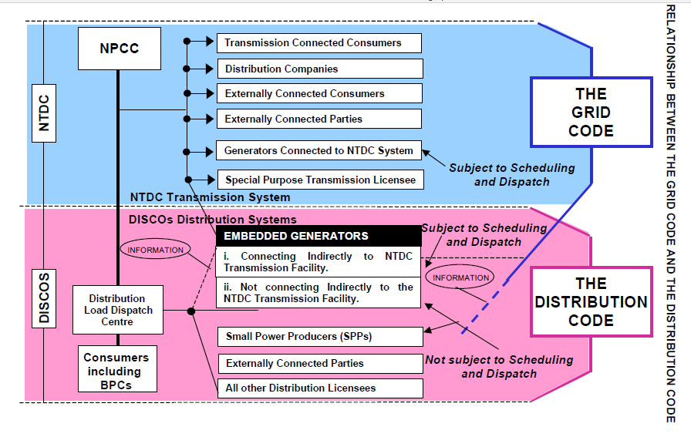

Slide 14
Distribution Operating Code:
Procedures on operational matters
operational planning, including demand forecasts, co-ordination of the planning of Licensee’s network outages and generation plant outages
the reporting of operational changes and events, safety matters and dealing with the procedures under contingencies.
Furthermore, it deals with the restoration of supply, load shedding, compliance of Performance Standards (Distribution).
Distribution Planning Code:
procedures on planning methodology and criteria related to the distribution planning of the Licensee.
It defines the standard of supply of the Licensee’s network, and the design principles to which it will be constructed, operated and maintained
Together with technical information and other requirements to be met by those requiring a connection to the Licensee’s network.
It also details the technical information exchange between parties relating to such connections.

Slide 15
Distribution Planning Code (DPC 5)
DISCOs shall prepare each year a short to medium term load forecast for a period of 5 (five) years
DISCOs shall adopt appropriate and established load forecasting methodology using reliable data and relevant indices.
Forecasting Methods:
Historical population and load growth analysis
Land use and zoning methods
End-use energy methods
Any other reasonable and justifiable method
Consumer category wise loads shall be identified
DISCOs shall work out the annual energy requirement and Peak Demand for each of the coming five years relating to each point of interconnection on the basis of its load forecast.

